Slide 1
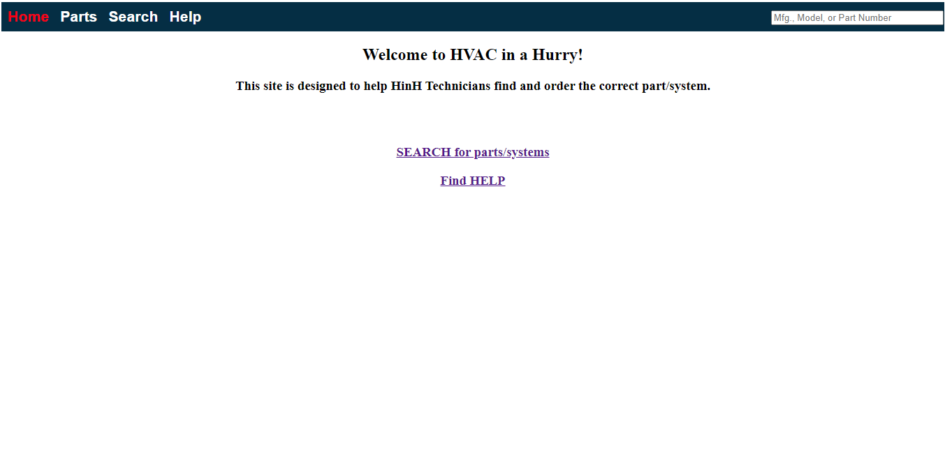
Add “Log On/Log Off” link/functionality
Make links available only to logged-in users
Add “Please Register and Log In to use this site”

